Slide 1






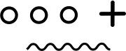
Light of Tiny-bit
RGB light exchange lighting
Yahboom

Slide 2









Contents
Preparation
Learning goal
Search for blocks
Combine blocks
Experimental phenomena
Yahboom

Slide 3

Preparation
1.The position of the RGB Searching lights in the robot car
2.Learn about the principle of RGB Searching light
Programming method:
Mode 1 online programming: First, we need to connect the micro:bit to the computer by USB cable. The computer will pop up a USB flash drive and click on the URL in the USB flash drive: http://microbit.org/ to enter the programming interface. Add the Yahboom package: https://github.com/YahboomTechnology/Tiny-bitLib to program.
Mode 2 offline programming: We need to open the offline programming software. After the installation is complete, enter the programming interface, click【New Project】, add Yahboom package: https://github.com/YahboomTechnology/Tiny-bitLib, you can program.
Yahboom

Slide 4
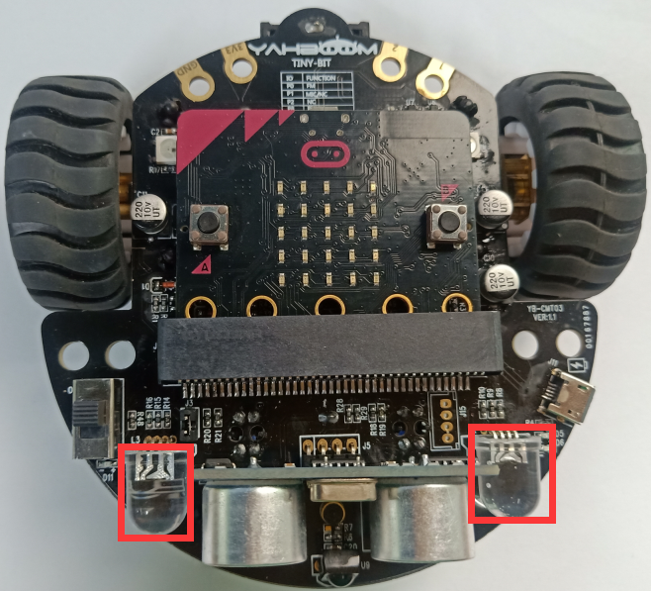
Preparation
In the picture shown below, the two lights with the red wire frame are the RGB Searching lights on the Tiny-bit.
Principle: RGB Searching light (red, green, blue) are packaged in the LED module. We can mix different colors(256*256*256) by controlling the brightness of the three LEDs.
Yahboom

Slide 5
Learning goal
1.Learn how to use RGB Searching lights graphically program building blocks
2.In this lesson, we will make color of all RGB Searching lights is changed every 1 seconds. Red -> Green -> Blue -> White -> Cyan -> Pinkish -> Yellow
Yahboom

Slide 6

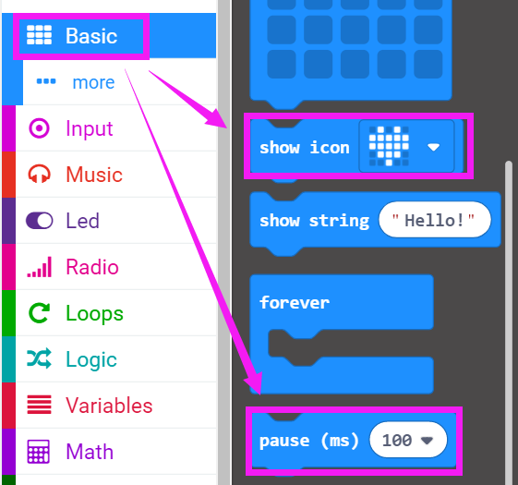
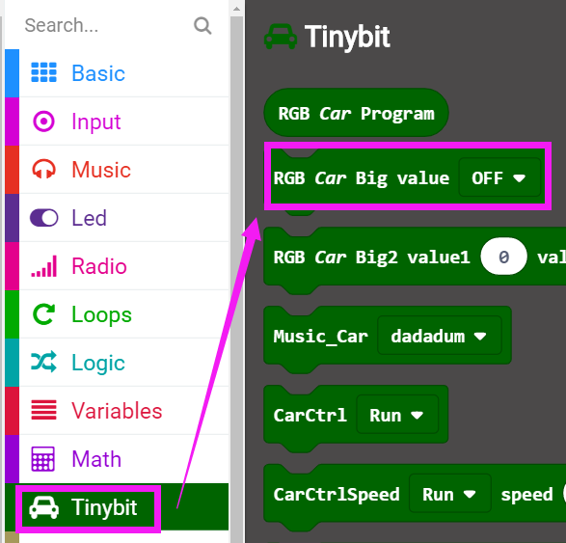
Search for block
The following is the location of the building blocks required for this programming.
Yahboom

Slide 7
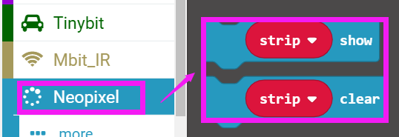
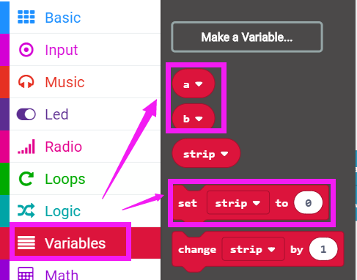
Search for block
Yahboom

Slide 8
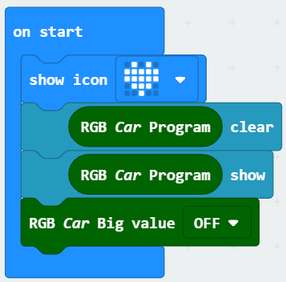
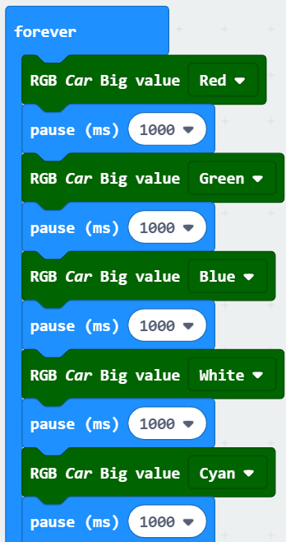
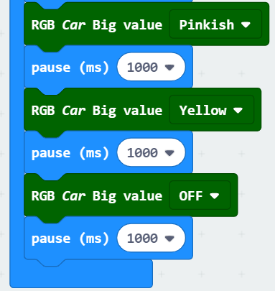
Combine block
The summary program is shown below:
Yahboom

Slide 9
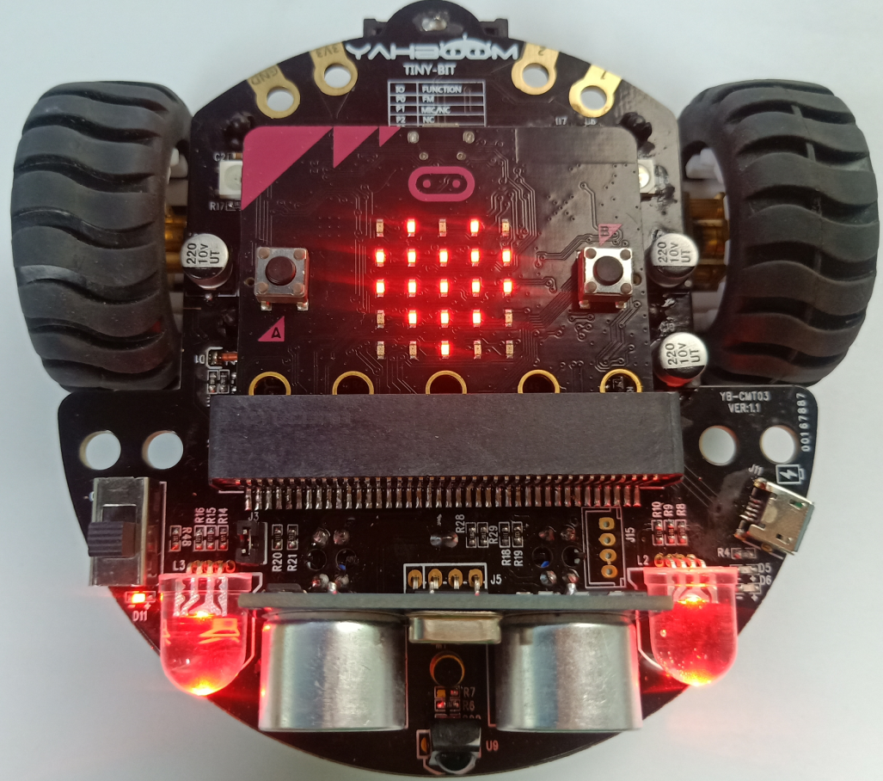
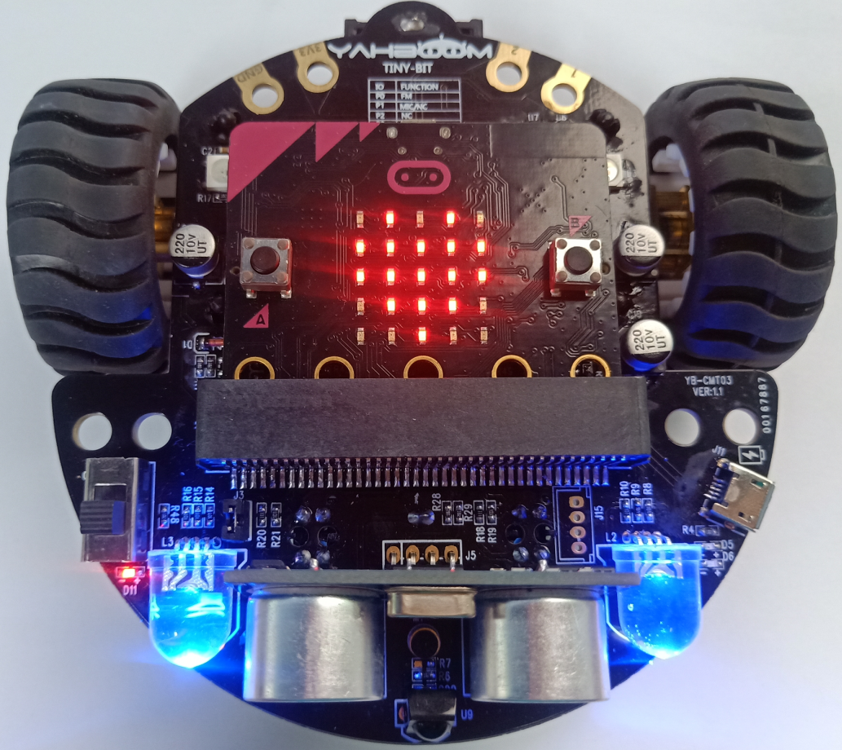
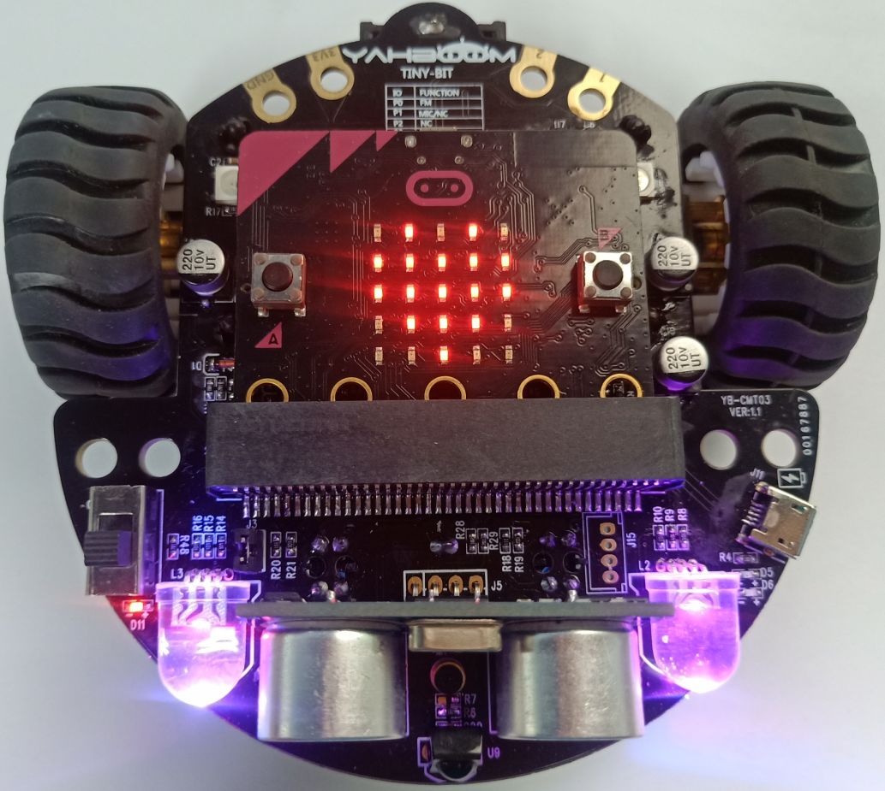
Experimental phenomena
After the program is downloaded, we can see that micro:bit board will display a heart pattern on the dot matrix. And the color of all RGB Searching lights is changed Red -> Green -> Blue -> White -> Cyan -> Pinkish -> Yellow every 1 seconds.
Yahboom

Slide 10
Inspire Creativity Embrace Innovation
Thank you!!!

